Slide 1
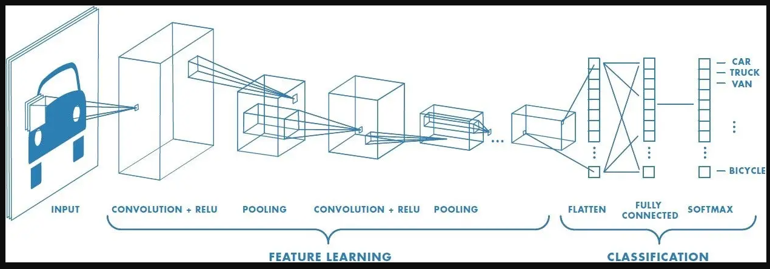
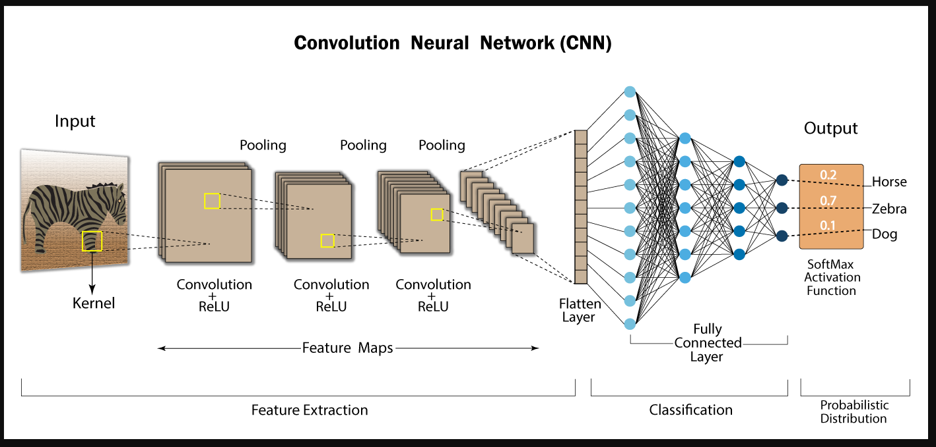
Assignment A07 - Manual CNN
Team EyeConic
Brooke Broderick - W217065417
Matthew Choo - W206744145
Cameroun White-W216530571
Melvis Maduagwu-W216890463
Erick Banegas - W2162009
Nancy Chieu-W000098778
Yoana Cook - W215913890
6252-ITAI-1378-Comp Vision-Artificial Intel-RT-15698 - Spring 2025
Professor Anna Devarakonda
March 8, 2025

Slide 2
Image : Kilogram weight
0 | 0 | 0 | 0 | 0 | 0 | 0 | 0
0 | 0 | 0 | +1 | +1 | 0 | 0 | 0
0 | 0 | 0 | +1 | +1 | 0 | 0 | 0
0 | 0 | +1 | +1 | +1 | +1 | 0 | 0
0 | 0 | +1 | +1 | +1 | +1 | 0 | 0
0 | 0 | +1 | +1 | +1 | +1 | 0 | 0
0 | 0 | +1 | +1 | +1 | +1 | 0 | 0
0 | 0 | 0 | 0 | 0 | 0 | 0 | 0

Slide 3
Parts of the Image
+1 | -1 | -1
+1 | +1 | -1
+1 | +1 | -1
-1 | -1 | -1
-1 | +1 | +1
-1 | +1 | +1
0 | 0 | 0 | 0 | 0 | 0 | 0 | 0
0 | 0 | 0 | +1 | +1 | 0 | 0 | 0
0 | 0 | 0 | +1 | +1 | 0 | 0 | 0
0 | 0 | +1 | +1 | +1 | +1 | 0 | 0
0 | 0 | +1 | +1 | +1 | +1 | 0 | 0
0 | 0 | +1 | +1 | +1 | +1 | 0 | 0
0 | 0 | +1 | +1 | +1 | +1 | 0 | 0
0 | 0 | 0 | 0 | 0 | 0 | 0 | 0
Fig 4 - right side
Fig 1- top
+1 | +1 | -1
+1 | +1 | -1
-1 | -1 | -1
-1 | -1 | +1
-1 | +1 | +1
-1 | +1 | +1
Fig 5 - Bottom Right side
Fig 2 - left side
-1 | +1 | +1
-1 | +1 | +1
-1 | -1 | -1
+1 | +1 | +1
+1 | +1 | +1
-1 | -1 | -1
Fig 3 - Bottom Left Side
Fig 6 - Center

Slide 4
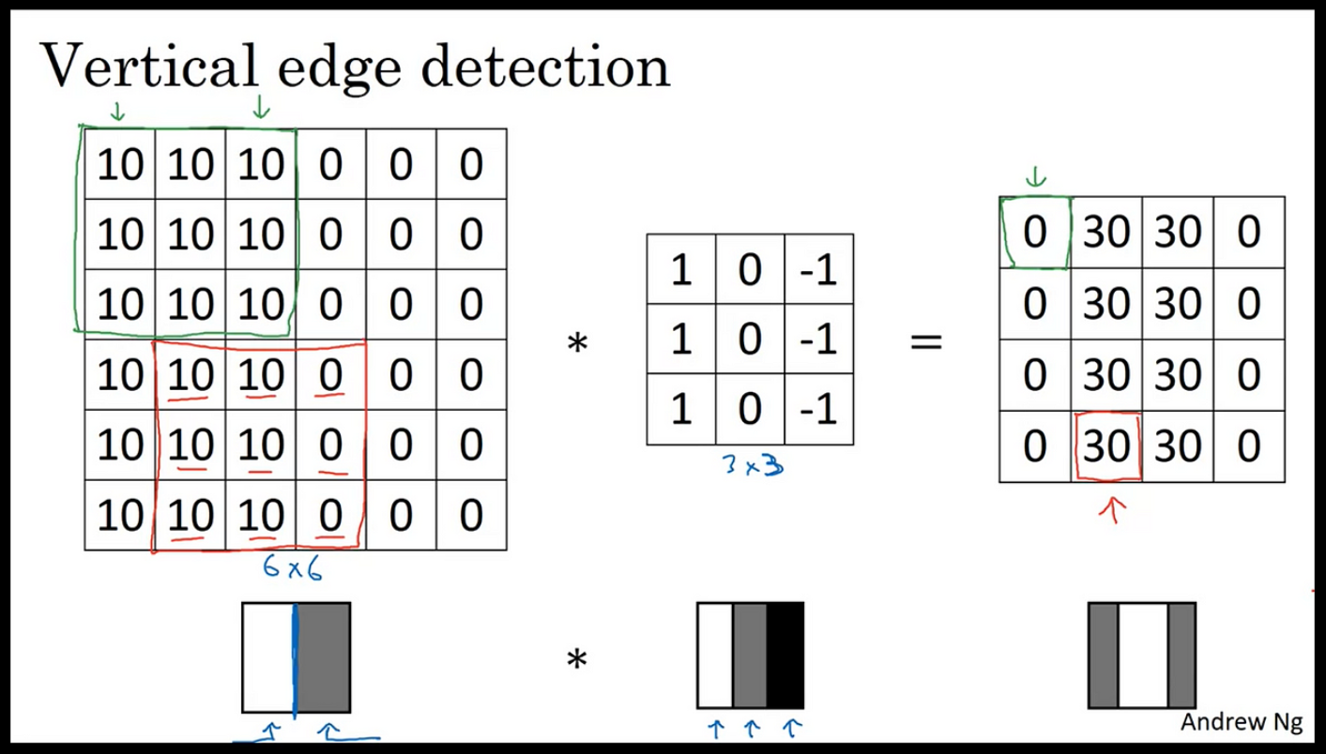
Using Vertical Edge Detection Filter
From Slides 5 - 10, we use the vertical edge detection filter on this image to find the highest and lowest values in the resulting grid.

Slide 5
Row 1; Position (1, 1):
Image Section:
0 0 0
0 0 0
0 0 0
Calculation:
(0*-1) + (0*0) + (0*1) = 0
(0*-1) + (0*0) + (0*1) = 0
(0*-1) + (0*0) + (0*1) = 0
Sum: 0 + 0 + 0 = 0
Row 1; Position (1, 2):
Image Section:
0 0 0
0 0 1
0 0 1
Calculation:
(0*-1) + (0*0) + (0*1) = 0
(0*-1) + (0*0) + (1*1) = 1
(0*-1) + (0*0) + (1*1) = 1
Sum: 0 + 1 + 1 = 2
Row 1; Position (1, 3):
Image Section:
0 0 0
0 1 1
0 1 1
Calculation:
(0*-1) + (0*0) + (0*1) = 0
(0*-1) + (1*0) + (1*1) = 1
(0*-1) + (1*0) + (1*1) = 1
Sum: 0 + 1 + 1 = 2
Row 1; Position( 1, 4):
Image Section:
0 0 0
1 1 0
1 1 0
Calculation:
(0*-1) + (0*0) + (0*1) = 0
(1*-1) + (1*0) + (0*1) = -1
(1*-1) + (1*0) + (0*1) = -1
Sum: 0 + (-1) + (-1) = -2
Row 1; Position (1, 5):
Image Section:
0 0 0
1 0 0
1 0 0
Calculation:
(0*-1) + (0*0) + (0*1) = 0
(1*-1) + (0*0) + (0*1) = -1
(1*-1) + (0*0) + (0*1) = -1
Sum: 0 + (-1) + (-1) = -2
Row 1; Position (1, 6):
Image Section:
0 0 0
0 0 0
0 0 0
Calculation:
(0*-1) + (0*0) + (0*1) = 0
(0*-1) + (0*0) + (0*1) = 0
(0*-1) + (0*0) + (0*1) = 0
Sum: 0 + 0 + 0 = 0

Slide 6
Row 2; Position (2, 1):
Image Section:
0 0 0
0 0 0
0 0 1
Calculation:
(0*-1) + (0*0) + (0*1) = 0
(0*-1) + (0*0) + (0*1) = 0
(0*-1) + (0*0) + (1*1) = 1
Sum: 0 + 0 + 1 = 1
Row 2; Position (2, 2):
Image Section:
0 0 0
0 0 1
0 1 1
Calculation:
(0*-1) + (0*0) + (0*1) = 0
(0*-1) + (0*0) + (1*1) = 1
(0*-1) + (1*0) + (1*1) = 1
Sum: 0 + 1 + 1 = 2
Row 2; Position (2, 3):
Image Section:
0 0 0
0 1 1
1 1 1
Calculation:
(0*-1) + (0*0) + (0*1) = 0
(0*-1) + (1*0) + (1*1) = 1
(1*-1) + (1*0) + (1*1) = 0
Sum: 0 + 1 + 0 = 1
Row 2; Position (2, 4):
Image Section:
0 0 0
1 1 0
1 1 1
Calculation:
(0*-1) + (0*0) + (0*1) = 0
(1*-1) + (1*0) + (0*1) = -1
(1*-1) + (1*0) + (1*1) = 0
Sum: 0 + (-1) + 0 = -1
Row 2; Position (2, 5):
Image Section:
0 0 0
1 0 0
1 1 0
Calculation:
(0*-1) + (0*0) + (0*1) = 0
(1*-1) + (0*0) + (0*1) = -1
(1*-1) + (1*0) + (0*1) = -1
Sum: 0 + (-1) + (-1) = -2
Row 2; Position (2, 6):
Image Section:
0 0 0
0 0 0
1 0 0
Calculation:
(0*-1) + (0*0) + (0*1) = 0
(0*-1) + (0*0) + (0*1) = 0
(1*-1) + (0*0) + (0*1) = -1
Sum: 0 + 0 + (-1) = -1

Slide 7
Row 3; Position (3, 1):
Image Section:
0 0 0
0 0 1
0 1 1
Calculation:
(0*-1) + (0*0) + (0*1) = 0
(0*-1) + (0*0) + (1*1) = 1
(0*-1) + (1*0) + (1*1) = 1
Sum: 0 + 1 + 1 = 2
Row 3; Position (3, 2):
Image Section:
0 0 0
0 1 1
1 1 1
Calculation:
(0*-1) + (0*0) + (0*1) = 0
(0*-1) + (1*0) + (1*1) = 1
(1*-1) + (1*0) + (1*1) = 0
Sum: 0 + 1 + 0 = 1
Row 3; Position (3, 3):
Image Section:
0 0 0
1 1 1
1 1 1
Calculation:
(0*-1) + (0*0) + (0*1) = 0
(1*-1) + (1*0) + (1*1) = 0
(1*-1) + (1*0) + (1*1) = 0
Sum: 0 + 0 + 0 = 0
Row 3; Position (3, 4):
Image Section:
0 0 0
1 1 1
1 1 1
Calculation:
(0*-1) + (0*0) + (0*1) = 0
(1*-1) + (1*0) + (1*1) = 0
(1*-1) + (1*0) + (1*1) = 0
Sum: 0 + 0 + 0 = 0
Row 3; Position (3, 5):
Image Section:
0 0 0
1 1 0
1 1 1
Calculation:
(0*-1) + (0*0) + (0*1) = 0
(1*-1) + (1*0) + (0*1) = -1
(1*-1) + (1*0) + (1*1) = 0
Sum: 0 + (-1) + 0 = -1
Row 3; Position (3, 6):
Image Section:
0 0 0
1 0 0
1 1 0
Calculation:
(0*-1) + (0*0) + (0*1) = 0
(1*-1) + (0*0) + (0*1) = -1
(1*-1) + (1*0) + (0*1) = -1
Sum: 0 + (-1) + (-1) = -2

Slide 8
Row 4; Position (4, 1):
Image Section:
0 0 1
0 1 1
0 1 1
Calculation:
(0*-1) + (0*0) + (1*1) = 1
(0*-1) + (1*0) + (1*1) = 1
(0*-1) + (1*0) + (1*1) = 1
Sum: 1 + 1 + 1 = 3
Row 4; Position (4, 2):
Image Section:
0 0 1
0 1 1
1 1 1
Calculation:
(0*-1) + (0*0) + (1*1) = 1
(0*-1) + (1*0) + (1*1) = 1
(1*-1) + (1*0) + (1*1) = 0
Sum: 1 + 1 + 0 = 2
Row 1; Position (4, 3):
Image Section:
0 1 1
1 1 1
1 1 1
Calculation:
(0*-1) + (1*0) + (1*1) = 1
(1*-1) + (1*0) + (1*1) = 0
(1*-1) + (1*0) + (1*1) = 0
Sum: 1 + 0 + 0 = 1
Row 1; Position( 4, 4):
Image Section:
1 1 1
1 1 1
1 1 1
Calculation:
(1*-1) + (1*0) + (1*1) = 0
(1*-1) + (1*0) + (1*1) = 0
(1*-1) + (1*0) + (1*1) = 0
Sum: 0 + 0 + 0 = 0
Row 1; Position (4, 5):
Image Section:
1 1 1
1 1 0
1 1 1
Calculation:
(1*-1) + (1*0) + (1*1) = 0
(1*-1) + (1*0) + (0*1) = -1
(1*-1) + (1*0) + (1*1) = 0
Sum: 0 + (-1) + 0 = -1
Row 1; Position (4, 6):
Image Section:
1 1 0
1 0 0
1 1 0
Calculation:
(1*-1) + (1*0) + (0*1) = -1
(1*-1) + (0*0) + (0*1) = -1
(1*-1) + (1*0) + (0*1) = -1
Sum: (-1) + (-1) + (-1) = -3

Slide 9
Row 5; Position (5, 1):
Image Section:
0 1 1
0 1 1
0 1 1
Calculation:
(0*-1) + (1*0) + (1*1) = 1
(0*-1) + (1*0) + (1*1) = 1
(0*-1) + (1*0) + (1*1) = 1
Sum: 1 + 1 + 1 = 3
Row 5; Position (5, 2):
Image Section:
0 1 1
0 1 1
1 1 1
Calculation:
(0*-1) + (1*0) + (1*1) = 1
(0*-1) + (1*0) + (1*1) = 1
(1*-1) + (1*0) + (1*1) = 0
Sum: 1 + 1 + 0 = 2
Row 5; Position (5, 3):
Image Section:
1 1 1
1 1 1
1 1 1
Calculation:
(1*-1) + (1*0) + (1*1) = 0
(1*-1) + (1*0) + (1*1) = 0
(1*-1) + (1*0) + (1*1) = 0
Sum: 0 + 0 + 0 = 0
Row 5; Position( 5, 4):
Image Section:
1 1 1
1 1 1
1 1 1
Calculation:
(1*-1) + (1*0) + (1*1) = 0
(1*-1) + (1*0) + (1*1) = 0
(1*-1) + (1*0) + (1*1) = 0
Sum: 0 + 0 + 0 = 0
Row 5; Position (5, 5):
Image Section:
1 1 1
1 1 0
1 1 1
Calculation:
(1*-1) + (1*0) + (1*1) = 0
(1*-1) + (1*0) + (0*1) = -1
(1*-1) + (1*0) + (1*1) = 0
Sum: 0 + (-1) + 0 = -1
Row 5; Position (5, 6):
Image Section:
1 1 0
1 0 0
1 1 0
Calculation:
(1*-1) + (1*0) + (0*1) = -1
(1*-1) + (0*0) + (0*1) = -1
(1*-1) + (1*0) + (0*1) = -1
Sum: (-1) + (-1) + (-1) = -3

Slide 10
Row 6; Position (6, 1):
Image Section:
0 1 1
0 1 1
0 0 0
Calculation:
(0*-1) + (1*0) + (1*1) = 1
(0*-1) + (1*0) + (1*1) = 1
(0*-1) + (0*0) + (0*1) = 0
Sum: 1 + 1 + 0 = 2
Row 6; Position (6, 2):
Image Section:
1 1 1
1 1 1
0 0 0
Calculation:
(1*-1) + (1*0) + (1*1) = 0
(1*-1) + (1*0) + (1*1) = 0
(0*-1) + (0*0) + (0*1) = 0
Sum: 0 + 0 + 0 = 0
Row 6; Position (6, 3):
Image Section:
1 1 1
1 1 1
0 0 0
Calculation:
(1*-1) + (1*0) + (1*1) = 0
(1*-1) + (1*0) + (1*1) = 0
(0*-1) + (0*0) + (0*1) = 0
Sum: 0 + 0 + 0 = 0
Row 6; Position( 6, 4):
Image Section:
1 1 1
1 1 1
0 0 0
Calculation:
(1*-1) + (1*0) + (1*1) = 0
(1*-1) + (1*0) + (1*1) = 0
(0*-1) + (0*0) + (0*1) = 0
Sum: 0 + 0 + 0 = 0
Row 6; Position (6, 5):
Image Section:
1 1 0
1 1 0
0 0 0
Calculation:
(1*-1) + (1*0) + (0*1) = -1
(1*-1) + (1*0) + (0*1) = -1
(0*-1) + (0*0) + (0*1) = 0
Sum: (-1) + (-1) + 0 = -2
Row 6; Position (6, 6):
Image Section:
1 0 0
1 0 0
0 0 0
Calculation:
(1*-1) + (0*0) + (0*1) = -1
(1*-1) + (0*0) + (0*1) = -1
(0*-1) + (0*0) + (0*1) = 0
Sum: (-1) + (-1) + 0 = -2

Slide 11
Original Image: Feature Map:
0 0 0 0 0 0 0 0 0 2 2 -2 -2 0
0 0 0 1 1 0 0 0 1 2 1 -1 -2 -1
0 0 0 1 1 0 0 0 2 1 0 0 -1 -2
0 0 1 1 1 1 0 0 3 2 1 0 -1 -3
0 0 1 1 1 1 0 0 3 2 0 0 -1 -3
0 0 1 1 1 1 0 0 2 0 0 0 -2 -2
0 0 1 1 1 1 0 0
0 0 0 0 0 0 0 0

Slide 12
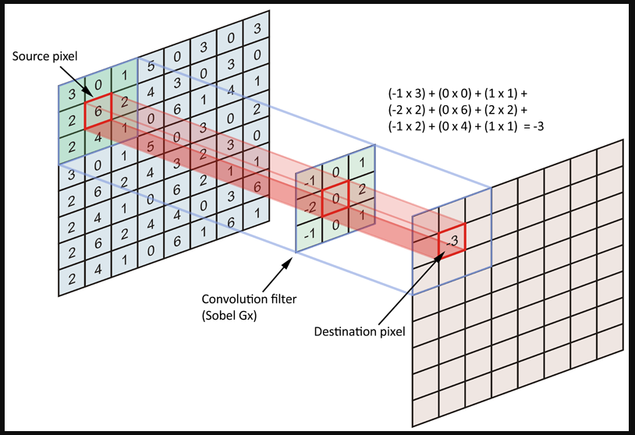
Understanding Convolutional Filters in Image Recognition
In this assignment, we have explored how convolutional filters work in image recognition by manually applying a filter to a simple image. Here’s a summary of what we did and what we learned:
The Original Image
We started with an 8x8 grid representing a simple image, a white square on a black background. Each cell in the grid had a value of 0 (black) or 1 (white). This image served as our starting point to understand how filters detect features, such as edges.
The Filter
We used a 3x3 vertical edge detector filter
-1 0 1
-1 0 1
-1 0 1
This filter is designed to detect vertical edges, which are sharp changes in pixel intensity from left to right. For example, it highlights the sides of the white square in our image.

Slide 13
Manual Convolution
We slid the filter over the image, one pixel at a time, and performed the convolution operation manually. This involved:
Multiplying each pixel in the image section by the corresponding value in the filter.
Summing the results to get a single value for the feature map. For example, when the filter was placed over the top-left corner of the image, the calculation looked like this:
Image Section: Filter: Calculation:
0 0 0 -1 0 1 (0*-1) + (0*0) + (0*1) = 0
0 0 0 -1 0 1 (0*-1) + (0*0) + (0*1) = 0
0 0 0 -1 0 1 (0*-1) + (0*0) + (0*1) = 0
Sum: 0 + 0 + 0 = 0
The Feature Map
After applying the filter, we obtained a 6x6 feature map. Here’s an example of what it looked like:
0 2 2 -2 -2 0
1 2 1 -1 -2 -1
2 1 0 0 -1 -2
3 2 1 0 -1 -3
3 2 0 0 -1 -3
2 0 0 0 -2 -2
High Positive Values (e.g., 2, 3): These indicate strong vertical edges on the left side of the square.
High Negative Values (e.g., -2, -3): These indicate strong vertical edges on the right side of the square.
Values Close to 0: These indicate areas with no significant vertical edges.

Slide 14
Interpretation and Key Takeaways:
The feature map shows where the filter detected vertical edges in the original image. For example:
The high positive values on the left side of the feature map correspond to the left edge of the square.
The high negative values on the right side correspond to the right edge of the square.
The zeros in the middle indicate no edges were detected there.
Convolutional filters are tools that help detect specific features (like edges) in an image.
By manually applying a filter, we saw how it highlights important parts of the image.
This process is the foundation of how convolutional neural networks (CNNs) work in image recognition.

Slide 15
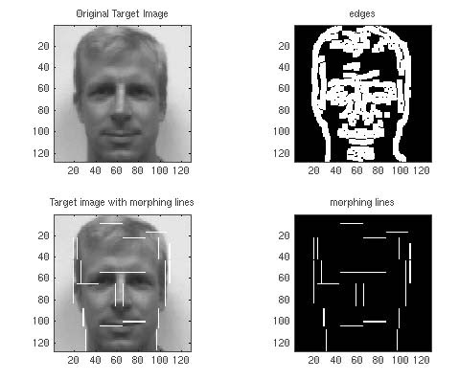
Conclusion:
Understanding how filters work helps us see how computers "see" and interpret images. It is the first step in teaching machines to recognize objects, faces, and other visual patterns.
This assignment gave us a hands-on understanding of convolutional filters and their role in image recognition. By manually applying a filter and analyzing the results, we learned how computers detect features like edges in images. This knowledge is essential for building and understanding more complex image recognition systems.

